Slide 1


Slide 2

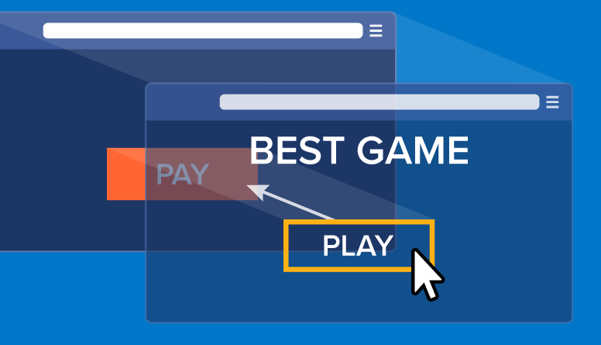

1. What is Clickjacking
2. Impact Of Clickjacking
3. How to find Clickjacking
4. Live Demo

Slide 3
What is Clickjacking ?
Clickjacking is a malicious technique of tricking a user into clicking on something different from what the user perceives, thus potentially revealing confidential information or allowing others to take control of their computer while clicking on seemingly innocuous objects, including web pages
The invisible page could be a malicious page, or a legitimate page the user did not intend to visit
Clickjacking won’t affect your site directly, but it could potentially affect your users.

Slide 4
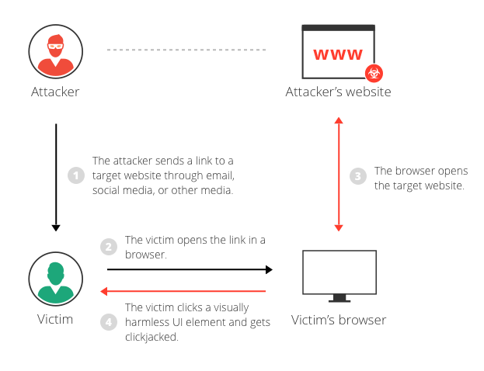
How Clickjacking vulnerability works..?

Slide 5
Impact Of Clickjacking
Attackers may abuse clickjacking vulnerabilities for many different purposes:
To gain followers on social media and then, possibly, sell the social media account/page for mass marketing.
To gain subscribers for the same purpose as social media followers.
To use the fact that the user is logged into their e-commerce account and have them buy products on behalf of the attacker.
To have the user unknowingly transfer funds to the attacker.
To have the user download malware (e.g. a trojan).

Slide 6
HOw to find Clickjacking vulnerability
Step 1 : First check the security headers of a web application https://securityheaders.com
Step 2 : Then use this script Change yoursite.com to target website and save the code
Step 3 : Copy Paste the following code in Notepad and save it as example.html
Step 4 : Open the example.html saved file in your browser
<html>
<head>
<title>Clickjack test page</title>
</head>
<body>
<p>Website is vulnerable to clickjacking!</p>
<iframe src="http://www.yoursite.com/sensitive-page" width="500" height="500"></iframe>
</body>
</html>

Slide 7
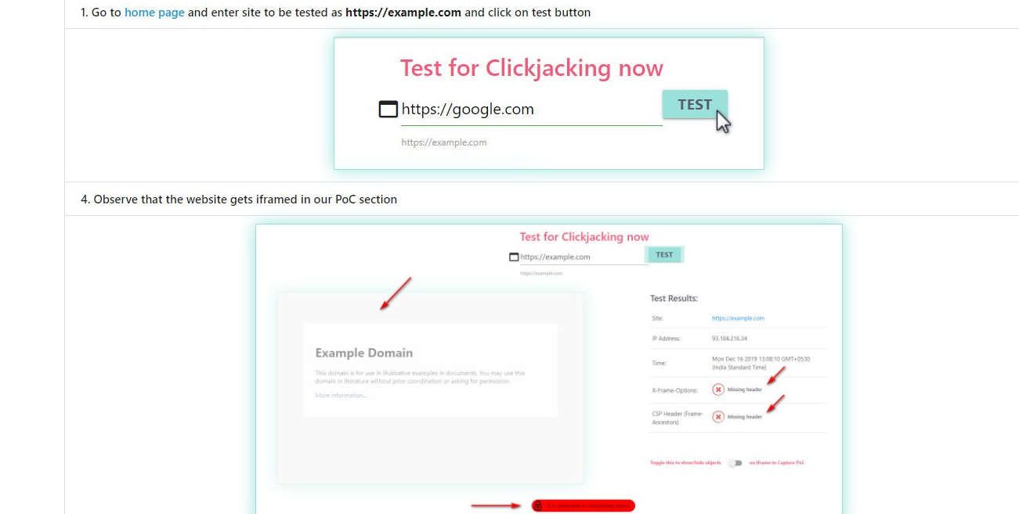
Tools to find Clickjacking Vulnerability
Link: https://clickjacker.io/
Link: https://github.com/shifa123/clickjackingpoc

Slide 8
THANK YOU

